Slide 1
Inline Styling

Slide 2
Agenda
Inline Styling
Sample output
Inline Styling implementation

Slide 3
Inline Styling
Inline styling is used to style one html tag at a time.
We use style attribute inside html tag with property and value.
Example:
<h1 style= “color:blue; background-color:Yellow;”>Header 1<h1>

Slide 4
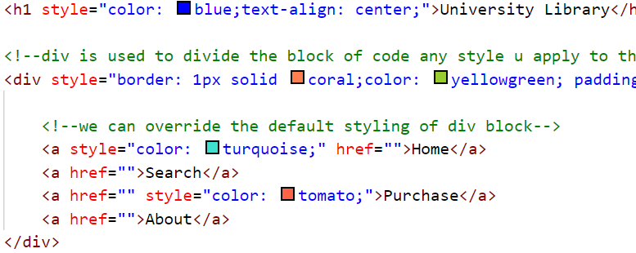
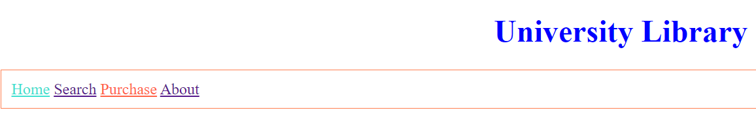
Sample output

Slide 5
Inline Styling implementation
Let us look at the basic implementation of Inline styling.

Slide 6
Summary
Inline styling is used to style one html tag at a time.
We use style attribute in the html tag to style.
DO NOT WRITE ANYTHING
HERE. LEAVE THIS SPACE FOR
WEBCAM

Slide 7
Thank You
Proprietary content. ©Great Learning. All Rights Reserved. Unauthorized use or distribution prohibited

